Slide 1
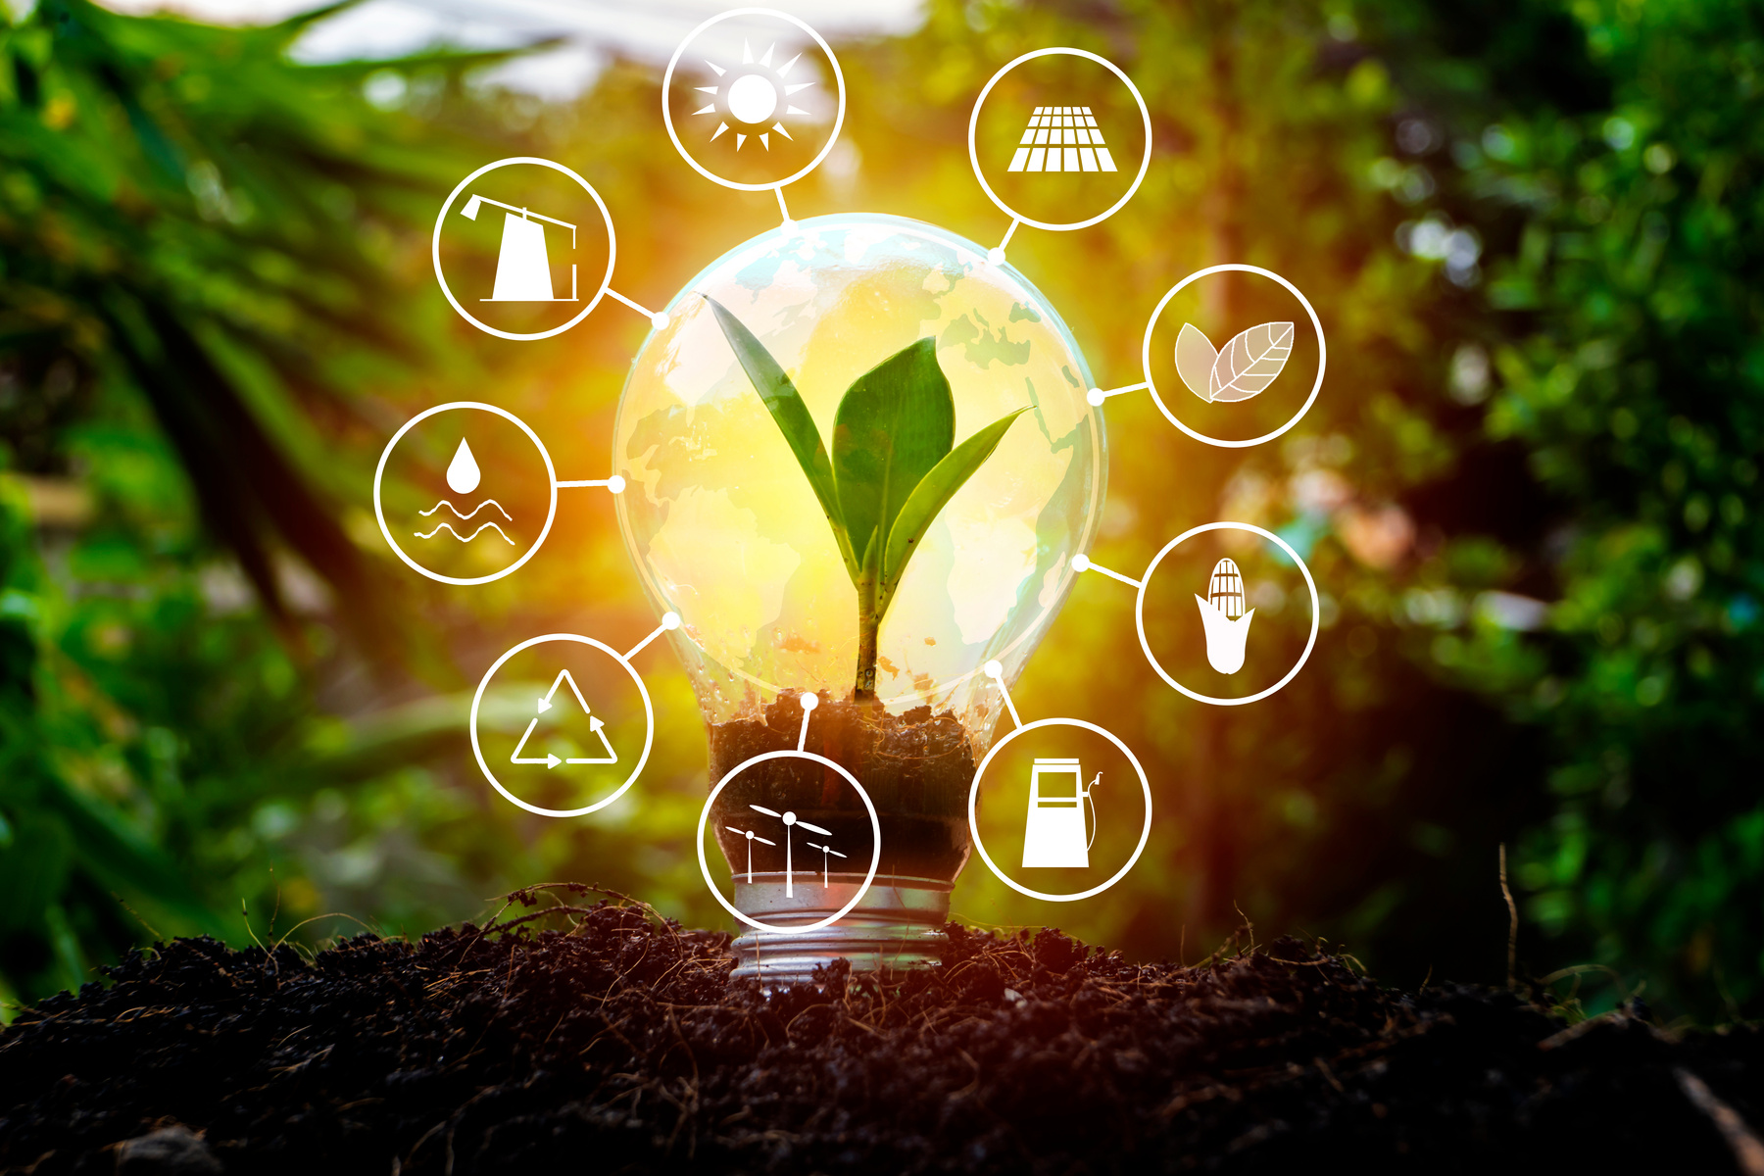
RENEWABLE ENERGY
SYSTEMS
Project 1
Group 12
Team Members:
Kevin Carney
Fatina Hamadi
Chris Hicks
Kade Rivers

Slide 2



https://github.com/musicmaj/project_1_group_12.git
Introduction
This project involves a detailed analysis of a dataset based on renewable energy systems that could be recreated to guide future investment decisions using up-to-date and factual scientific data. Team members used Python in Jupyter Notebook with Matplotlib for data visualization. The dataset from Kaggle covers randomized metrics on renewable energy forms, such as storage capacities, production amounts, investments, financial incentives, and environmental impacts.
It is important to note the learning curve for dataset discovery and authenticity for novice data analysts. Having utilized a dataset with a large amount of information that was seemingly clean, upon creating visualizations and analyzing the data at hand, it became apparent the dataset was not as factual as it first appeared.
Through the use of visualizations, data analysis, and comparison to other data about renewable energy systems, funding allegations for renewable energy, and job creation statistics, we were able to determine the dataset originally selected was not factual simply with the prior knowledge we had along with our developing skills in data analysis and visualization. Upon further research and digging into the dataset, we were able to confirm our suspicions that this dataset was a randomized dataset for the purposes of education on data analysis and visualization on the Kaggle website.
Although the information in this dataset is not factual data, we believe it is highly beneficial to go through this learning process to showcase our developing skills in data analytics and visualizations regardless of the dataset we are given.
With such information detailed at the beginning of this presentation, we will be discussing the data within this dataset, what this particular dataset shows us, as well as providing a bit of factual information that was found during additional research to help guide our analysis.

Slide 3
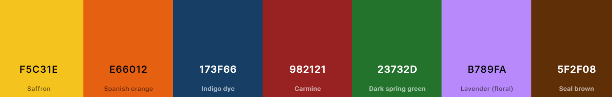
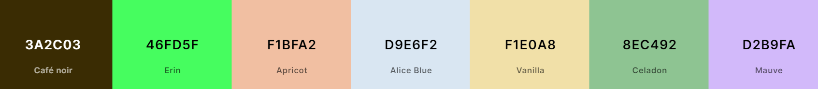
Color Palette
We began with a color palette to have a single color represent each of the various energies in the project.
Solar Wind Hydroelectric Geothermal Biomass Tidal Wave
We then added complimentary colors throughout the visualizations and presentation for easier reading.

Slide 4
Production Vs Consumption
An analysis of the usable energy

Slide 5
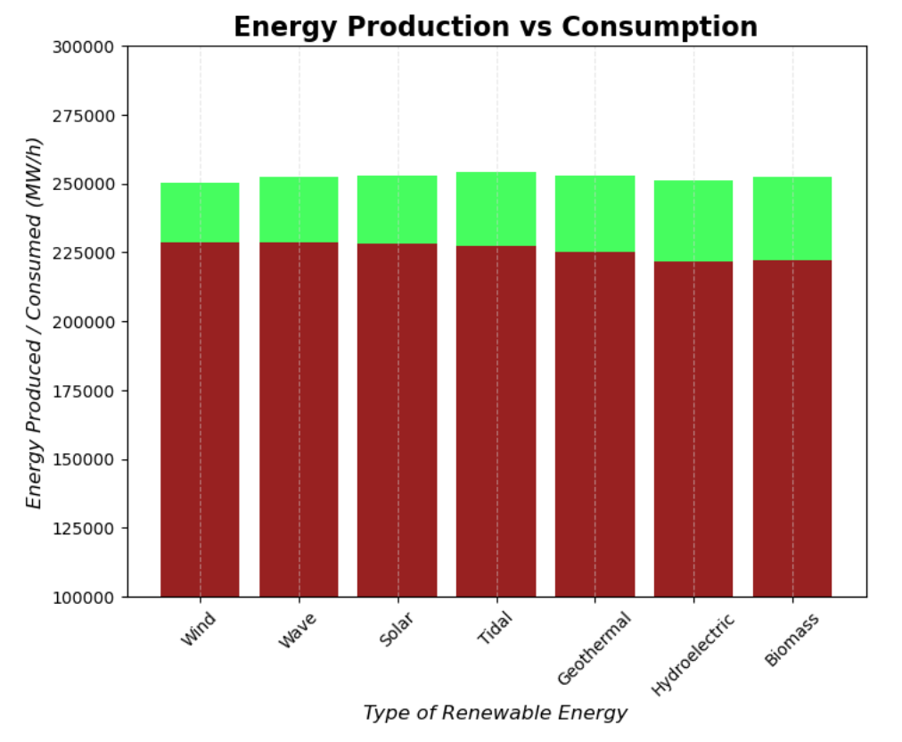
*Disclaimer: The data in this dataset and presentation is for educational purposes only and should not be used when determining financial investments.

Slide 6
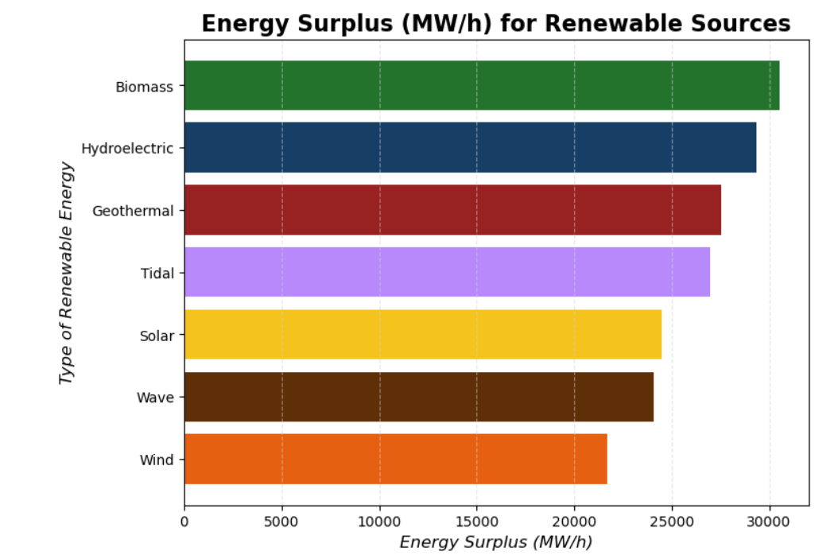
*Disclaimer: The data in this dataset and presentation is for educational purposes only and should not be used when determining financial investments.

Slide 7
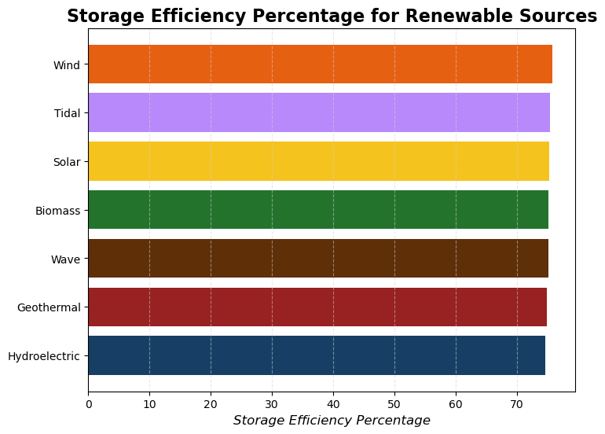
*Disclaimer: The data in this dataset and presentation is for educational purposes only and should not be used when determining financial investments.

Slide 8
Financial Incentives
Vs
Initial Investments
An analysis of the data for financial purposes

Slide 9
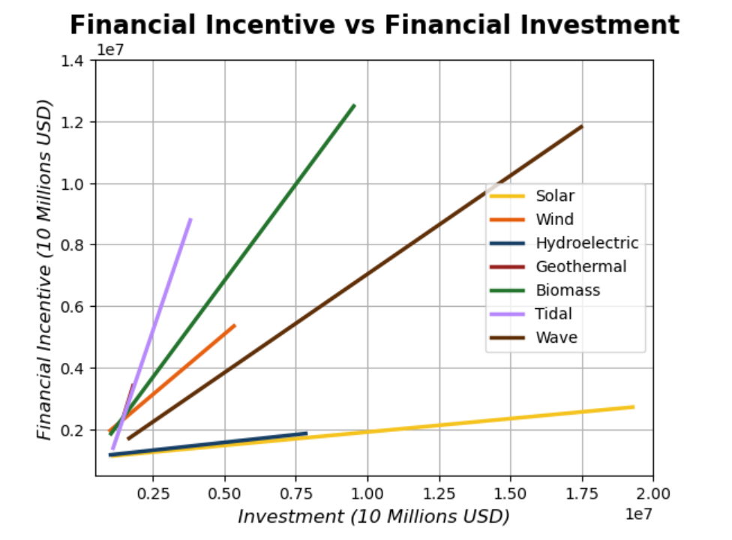
Highlights
Tidal and Geothermal Energies yield a higher financial incentive with a smaller investment.
Solar and Hydroelectric Energies require a higher investment amount with far less financial incentive
Biomass, Wind, and Wave Energies will have a higher incentive as the investment increases.
*Disclaimer: The data in this dataset and presentation is for educational purposes only and should not be used when determining financial investments.

Slide 10
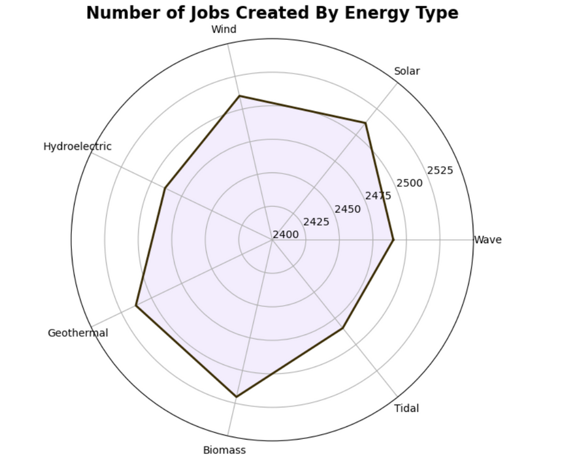
Highlights
Looking at financial incentives vs initial investment is important, as is looking into the amount of jobs created
There isn’t a staggering difference in the amount of jobs created per energy type, however, looking at the financial incentive along with the amount of jobs that will potentially be created will allow for future growth.
*Disclaimer: The data in this dataset and presentation is for educational purposes only and should not be used when determining financial investments.

Slide 11
Most Widely Used
Renewable Energies
An analysis of the data for usage and popularity

Slide 12
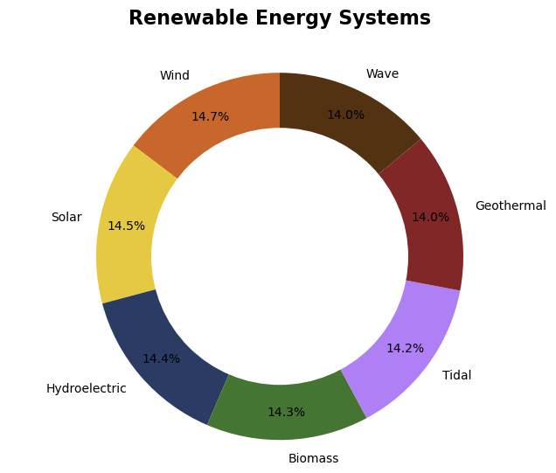
*Disclaimer: The data in this dataset and presentation is for educational purposes only and should not be used when determining financial investments.

Slide 13
Additional Resources with data and studies:
Reference: Which Renewable Energy Sources Are Most Reliable?
Reference: Which renewable energy created the most jobs?

Slide 14
Linear Regression
Renewable energy production parameter analysis

Slide 15
How do we interpret our findings in a social context?

Slide 16
What are the connections?
Notes:
An explanation of the perimeter of the variables

Slide 17
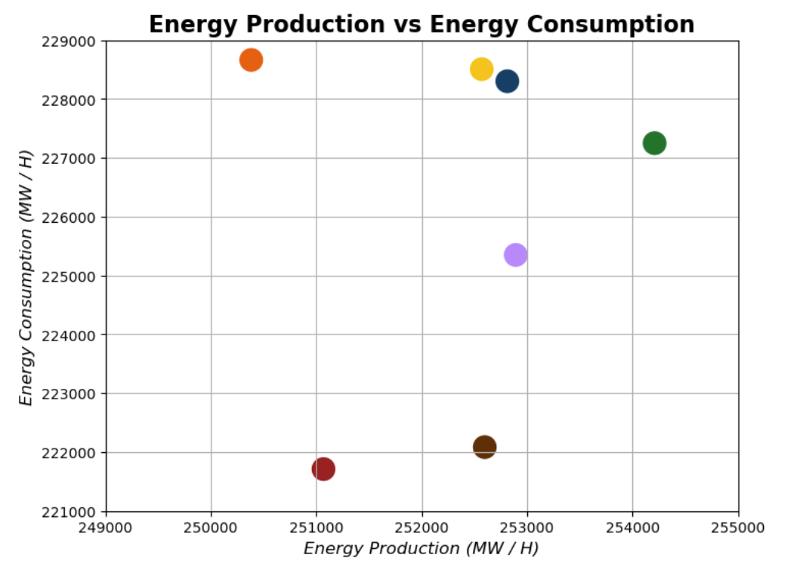

Slide 18
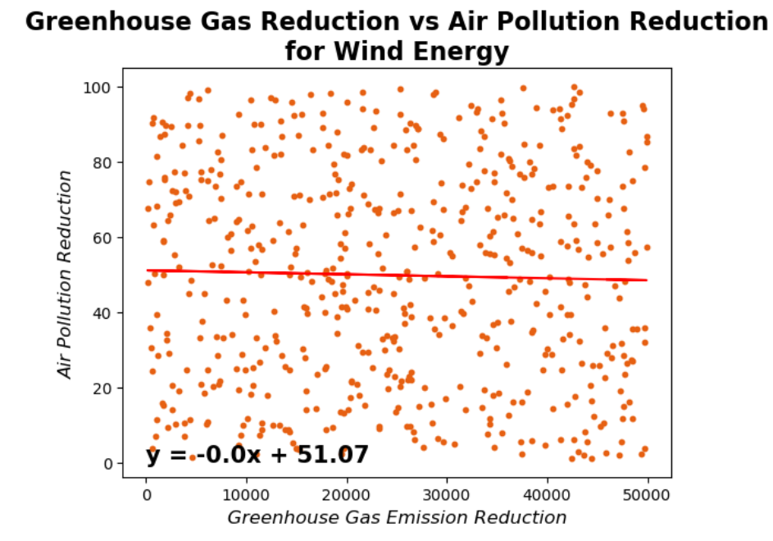
The Correlation between Wind Energy Productions Greenhouse gas Emissions vs. Air Pollution Reduction
Positives

Slide 19
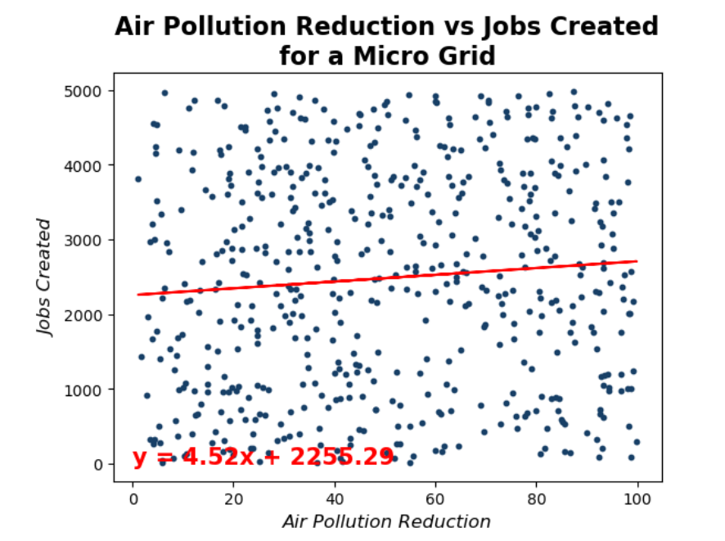
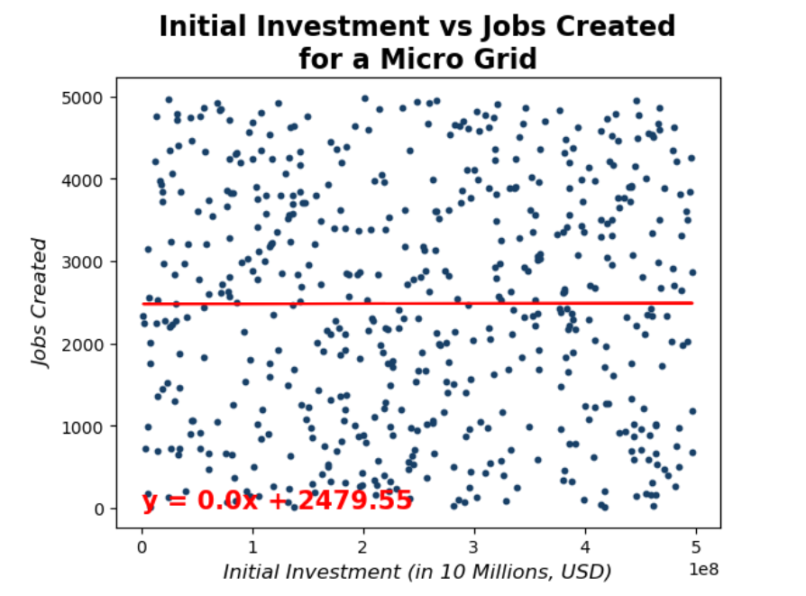
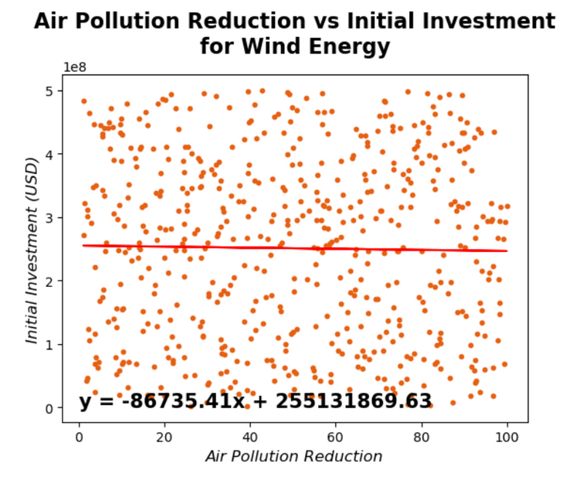
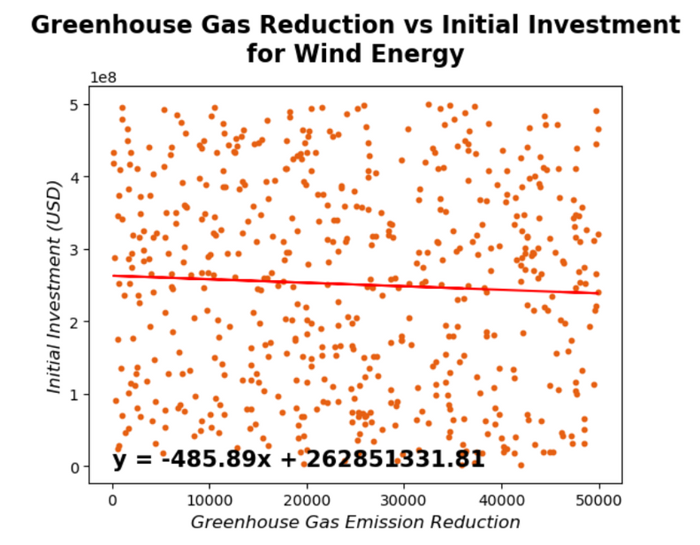
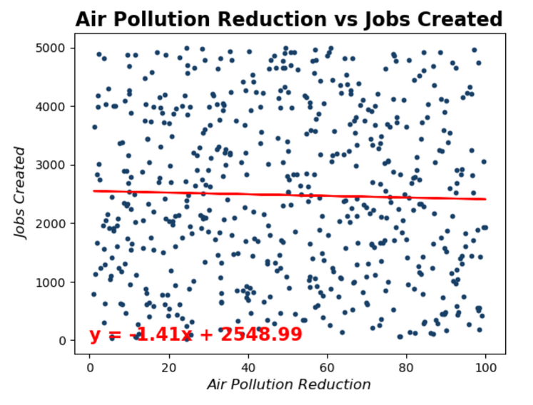

Slide 20

Conclusions,
Project Challenges,
and Learning Opportunities
An analysis of ourselves and our knowledge gained throughout this project.

Slide 21
Conclusions:
From careful analysis and visualizations from the dataset we were able to determine that the dataset was not accurate.
Through further explorations of available resources and digging further into the source of the dataset, we were able to confirm our suspicions.
Although our analysis of this dataset is not viable for recommendations or predictions for future outcomes, we have gained further knowledge and will be able to do future research, analysis, and visualizations with more confidence and accuracy.
Project Difficulties and Learning Opportunities:
The first difficulties arose when the curated data had large amounts of data but that all of the data was very similar--even against what we would have predicted.
The dataset lacked a timeline which made growth and predictions harder to determine and visualize.
The dataset lacked geographic locations for the renewable energies which could significantly impact the incentives and outcome of a new investment
These difficulties allowed us the learning opportunity to truly scrutinize our future datasets for accuracy, viability, and full analyzation for aspects that would be important for a company or investor interested in our skills.
In creating a project based on randomized data, we learned a large variety of ways to work through that data to fully immerse ourselves into the project to discover any sort of patterns that existed, and we gained further skills and knowledge to use in the future.

